Slide 1
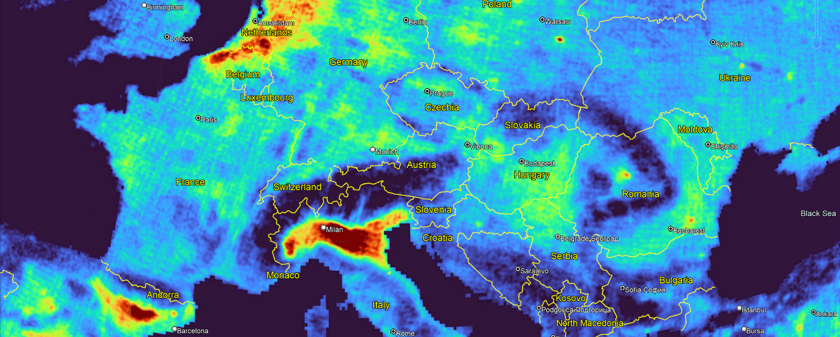
Aircraft observations of NH₃ from industrial and agricultural sources Lara Noppen, Lieven Clarisse, Frederik Tack, Thomas Ruhtz, Alexis Merlaud, Martin Van Damme, Michel Van Roozendael, Dirk Schuettemeyer and Pierre Coheur
NH₃ HRI distribution from IASI measurements

Slide 2
The global nitrogen cycle
Key forms of reactive nitrogen (Nr) :
Nitrogen dioxide (NO₂)
Ammonia (NH₃)
Anthropogenic emissions of Nr disturb the global nitrogen cycle → devastating consequences to biodiversity, soil, water, and air quality
Effective monitoring is needed !
NH₃
NO₂
European Environment Agency, https://www.eea.europa.eu/data-and-maps/daviz/trends-in-eu-27-emissions-1#tab-googlechartid_chart_11

Slide 3
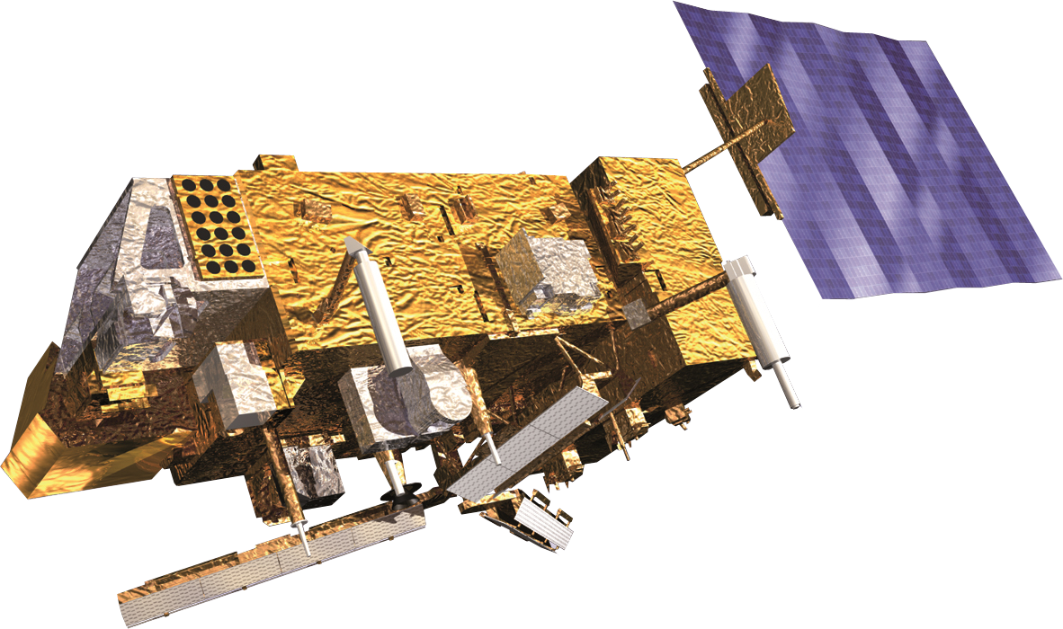
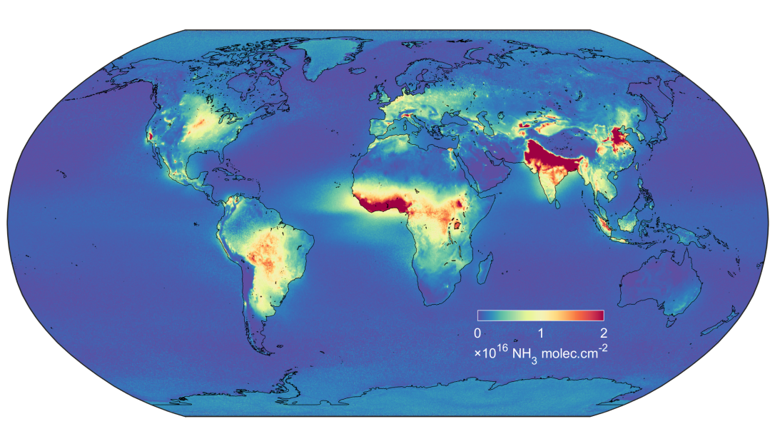
Satellite observations of NH₃
IASI sounder
Global distribution of NH₃ columns from 11 years of IASI measurements → importance of point sources
Poultry housing
Fertilizer plant
Van Damme, M. et al. (2018). Industrial and agricultural ammonia point sources exposed. Nature, 564(7734): 99–103.

Slide 4
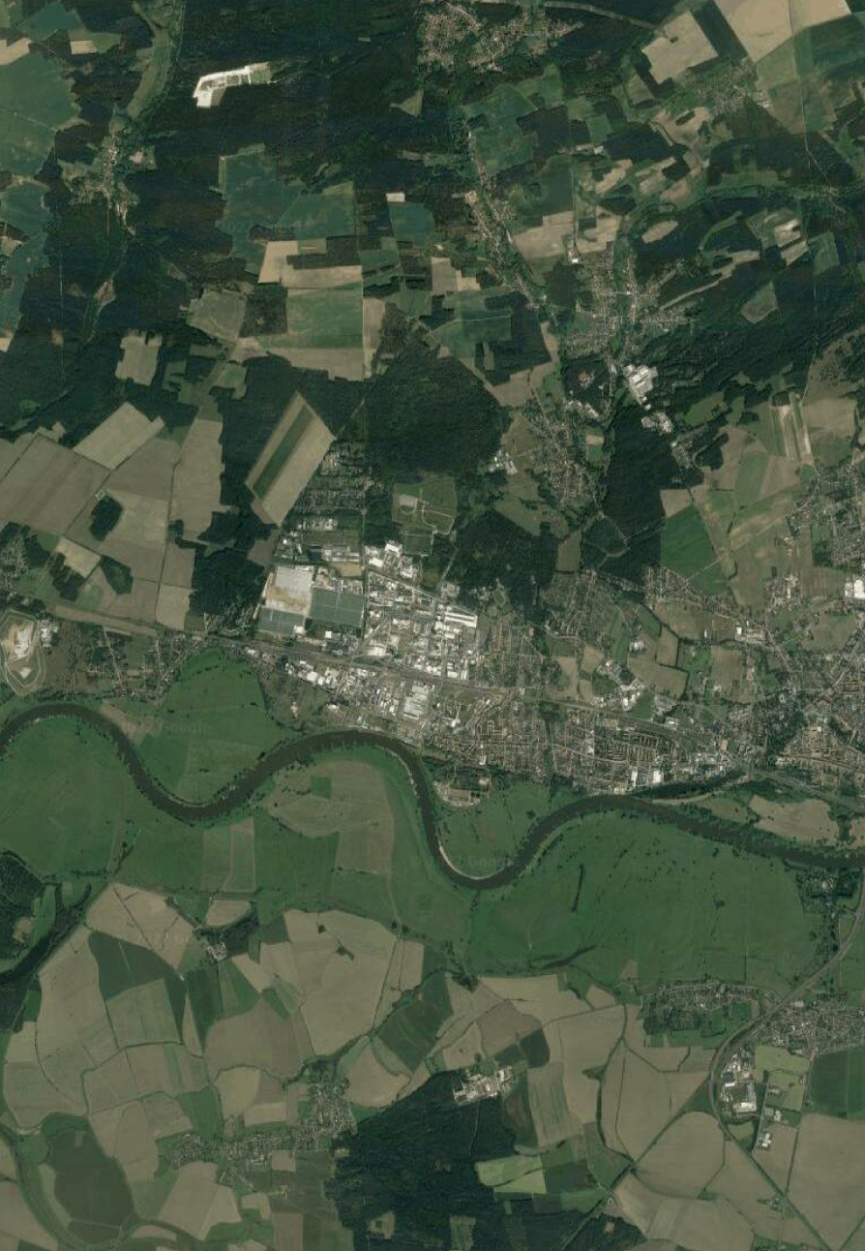
Limitations of current satellite measurements
IASI measurements of NH₃
Concentrated Animal Feeding Operation
Spatial resolution of current satellites too coarse (~ 10 km)
Poultry
Pigs
Mixed
Nitrosat
Satellite mission proposed for the 11th ESA's Earth Explorer call (phase 0)
Simultaneous observations of NO₂ and NH₃ at < 500 m resolution
NITROCAM
Airborne measurements of both species at very high spatial resolution
Coheur, P. et al. (2020). NITROSAT : Mapping reactive nitrogen at the landscape scale. Technical report.
z
y
Fertilizer plant
x

Slide 5
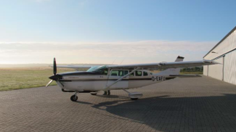
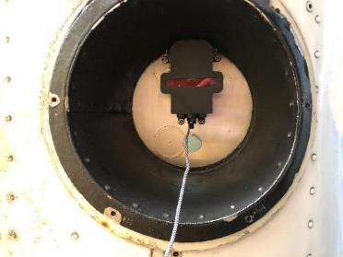
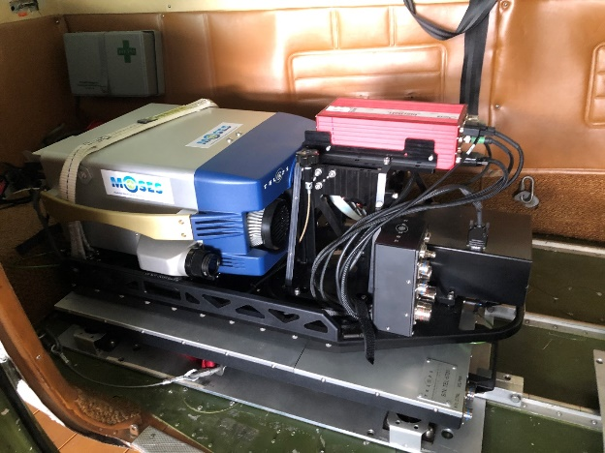
NITROCAM campaigns
Instruments on board the aircraft Cessna 207T:
SWING → NO₂
Hyper-Cam LW → NH₃
SWING
 | SWING | Hyper-Cam LW
Wavelength range | 280 – 550 nm | 800 – 1350 cm⁻¹
Spectral resolution (FWHM) | 0.7 nm | 1.2 – 1.6 cm⁻¹
FOV across-track | 100° | 25.7° max
IFOV across track | 3° | 0.08°
Swath width | 2900 m | 1350 m
Ground speed | 60 m.s⁻¹ | 51 m.s⁻¹
Exposure time | 0.5 s | 2.29 s
Spatial resolution | 170 m | 5 m
Weight | 3 kg | 140 kg
Size (L x W x H) | 20 x 20 x 30 cm³ | 100 x 60 x 50 cm³
Scanning | Whiskbroom | Imaging Fourier interferometer
Target platform | UAV/aircraft | Aircraft
Hyper-Cam LW

Slide 6
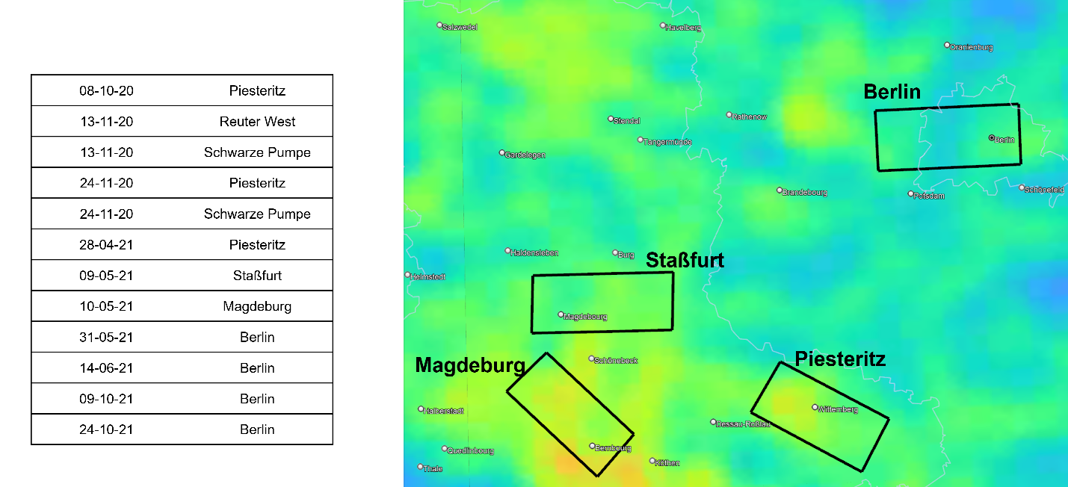
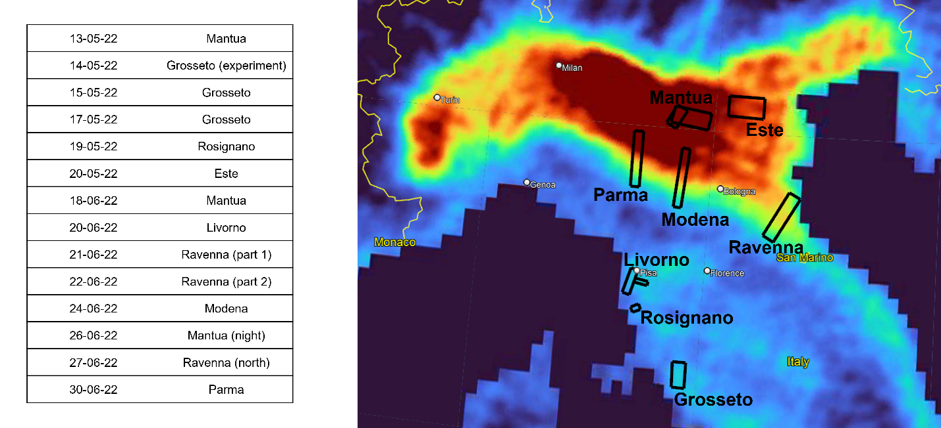
NITROCAM campaigns
Germany flights
Italy flights
(2020-2021)
(2022)

Slide 7
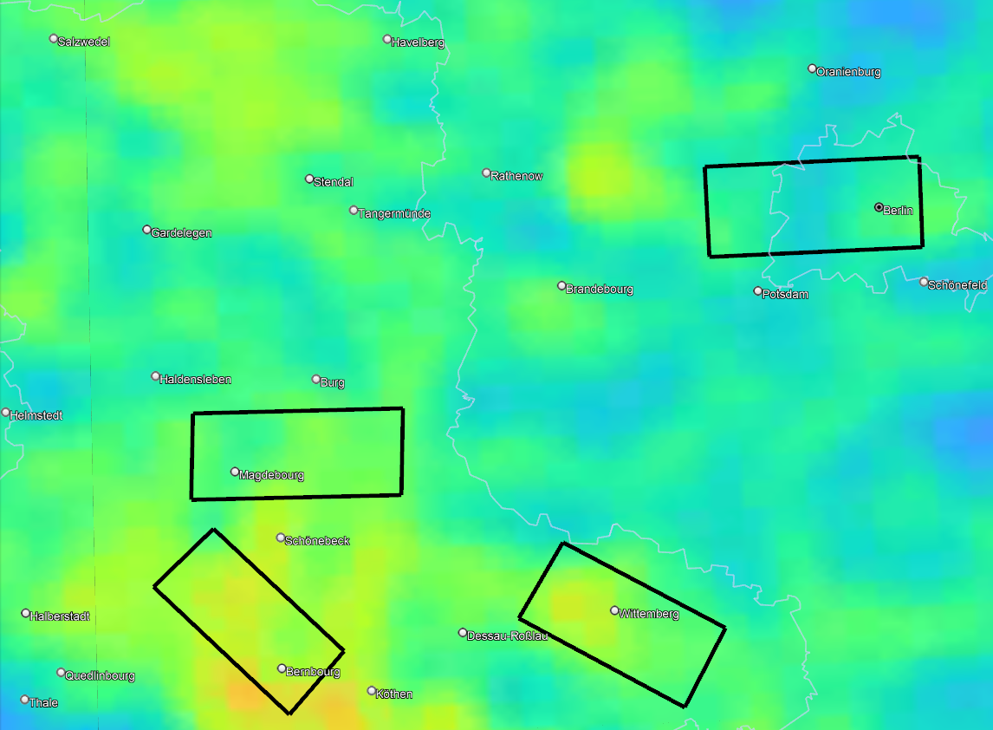
Germany flights
08-10-20 | Piesteritz
13-11-20 | Reuter West
13-11-20 | Schwarze Pumpe
24-11-20 | Piesteritz
24-11-20 | Schwarze Pumpe
28-04-21 | Piesteritz
09-05-21 | Staßfurt
10-05-21 | Magdeburg
31-05-21 | Berlin
14-06-21 | Berlin
09-10-21 | Berlin
24-10-21 | Berlin
Berlin
Staßfurt
Magdeburg
Piesteritz

Slide 8
Germany flights
08-10-20 | Piesteritz
28-04-21 | Piesteritz
09-05-21 | Staßfurt
Berlin
Staßfurt
Magdeburg
Piesteritz

Slide 9
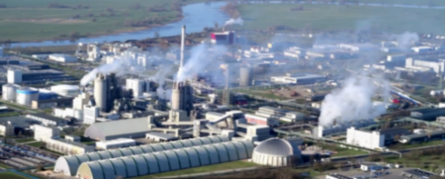
Germany flight – Piesteritz
Flight over the industrial site of Piesteritz in autumn 2020
Measurements of NH₃ by the Hyper-Cam instrument in the infrared at a spatial resolution of 4 m
Mean spectrum
Solar panels

Slide 10
Piesteritz – NH₃ plume
Detection of NH₃ with the HRI method (or matched filter)
$$HRI=\frac{K^{T}S_{y}^{−1}\left(y−\overline{y}\right)}{\sqrt{K^{T}S_{y}^{−1}K}}$$
HRI > 0
HRI = 0
HRI < 0

Slide 11
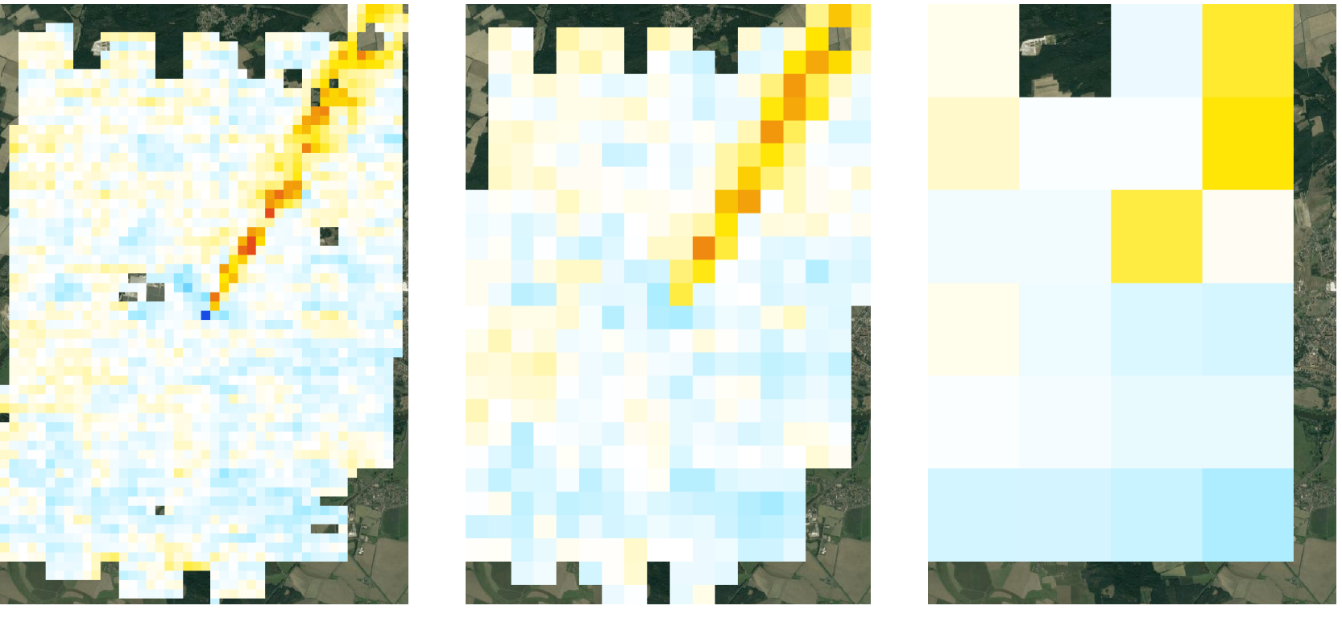
Piesteritz – Various satellite footprints
Progressive degradation of the spatial resolution of HRI distribution
Sub-km spatial resolution required to identify the point source
Nitrosat
12 m
200 m
500 m
2000 m
-3 -2 -1 0 1 2 3
HRI
-10 -6 -2 0 2 6 10
HRI
-10 -6 -2 0 2 6 10
HRI
-10 -6 -2 0 2 6 10
HRI

Slide 12
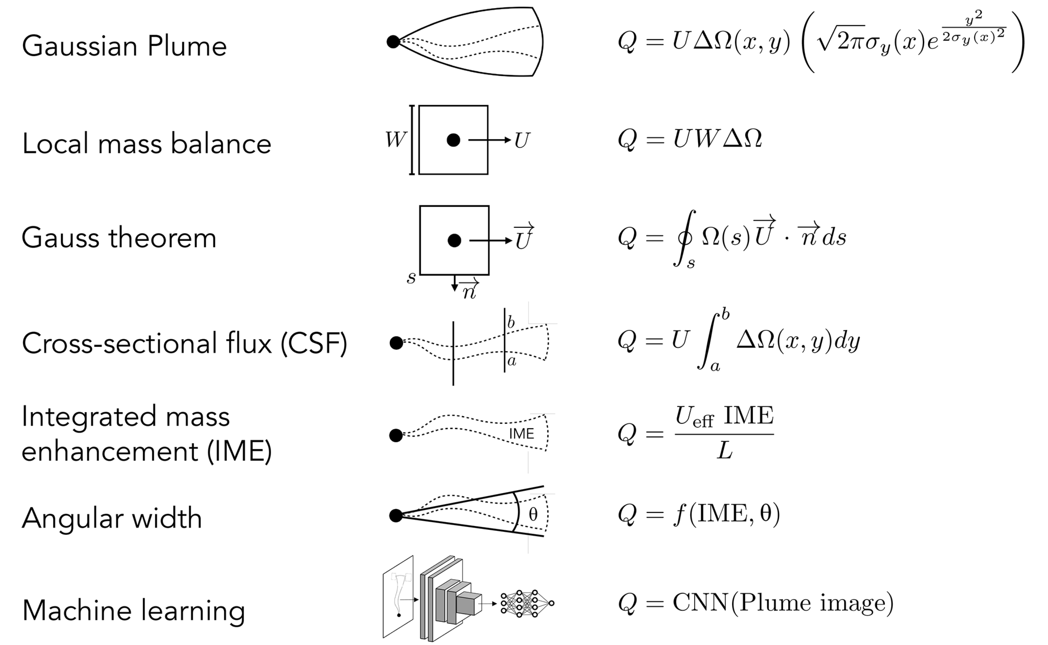
Deriving point source emission rates
Two most accurate and practically applicable approaches
Jacob, D. J., et al. (2022). Quantifying methane emissions from the global scale down to point sources using satellite observations of atmospheric methane, Atmos. Chem. Phys., 22, 9617–9646.

Slide 13
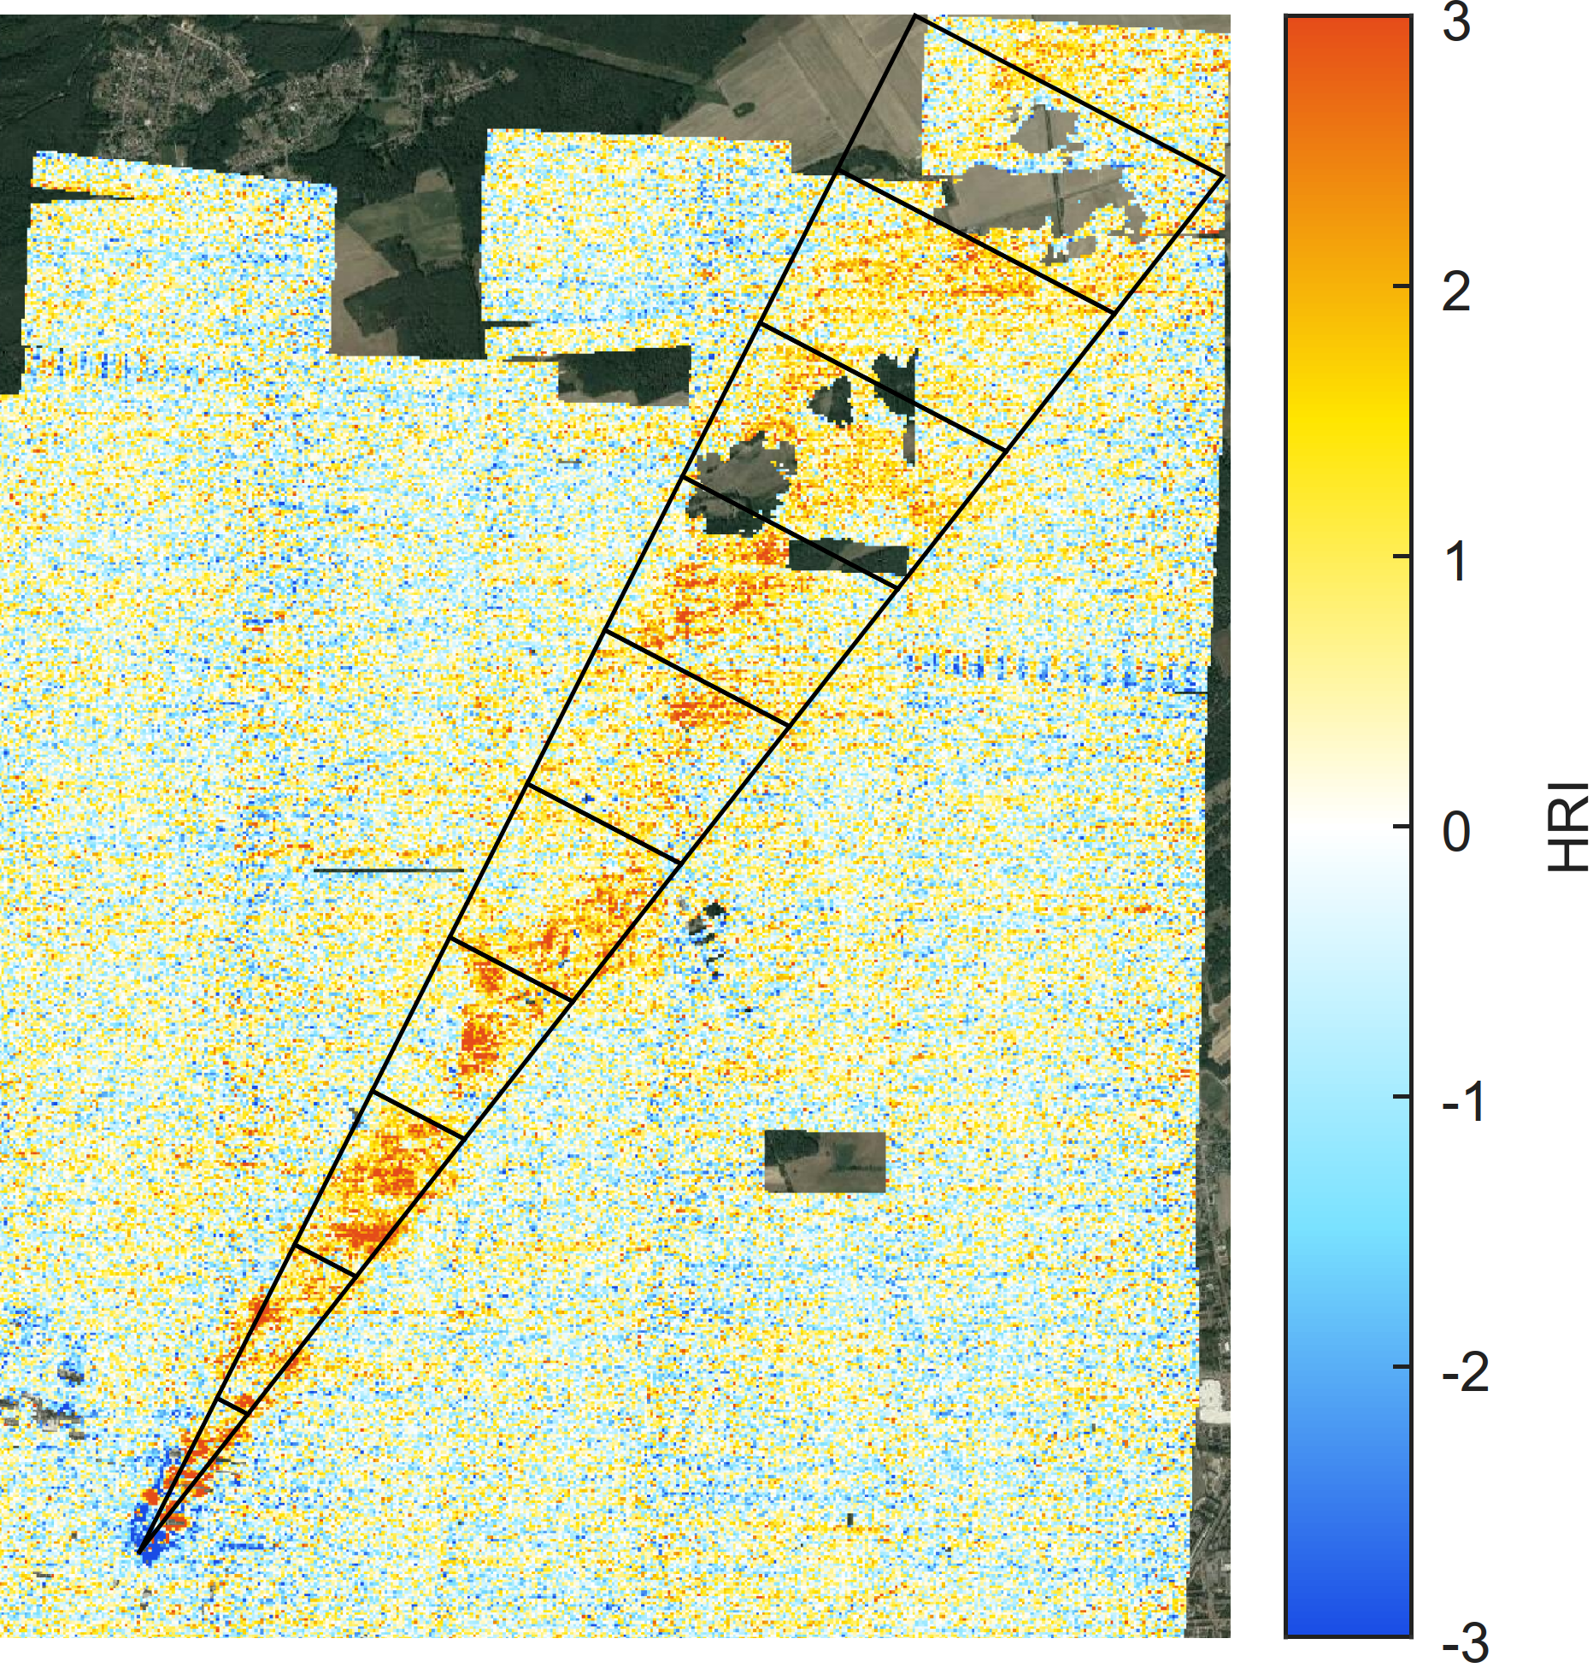
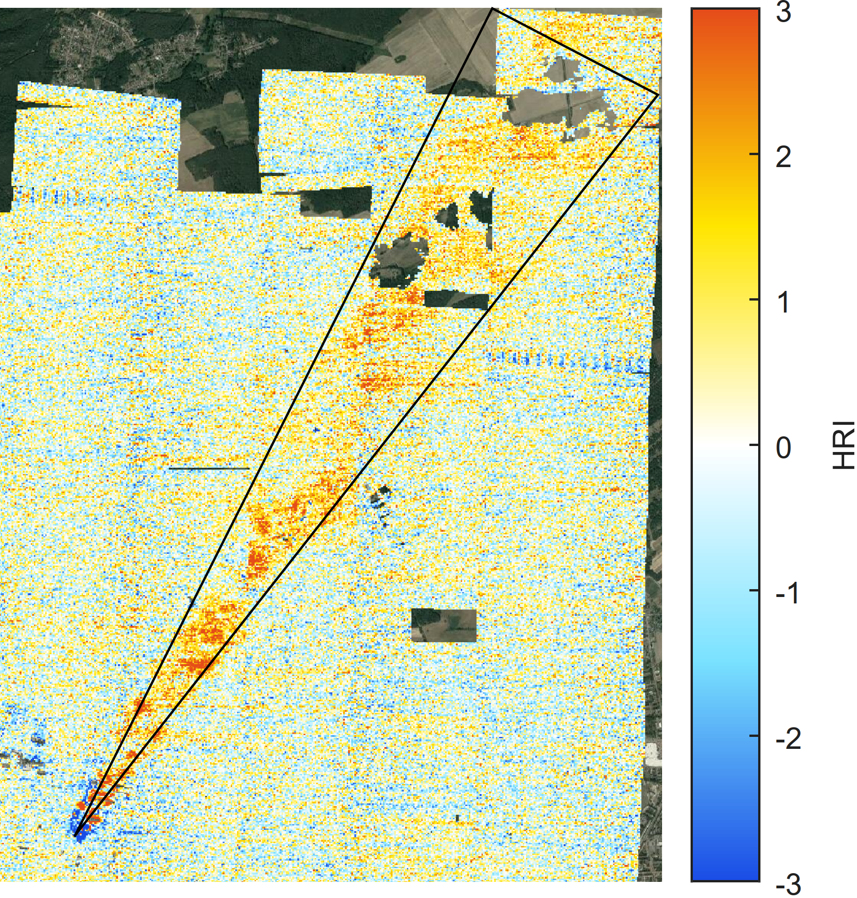
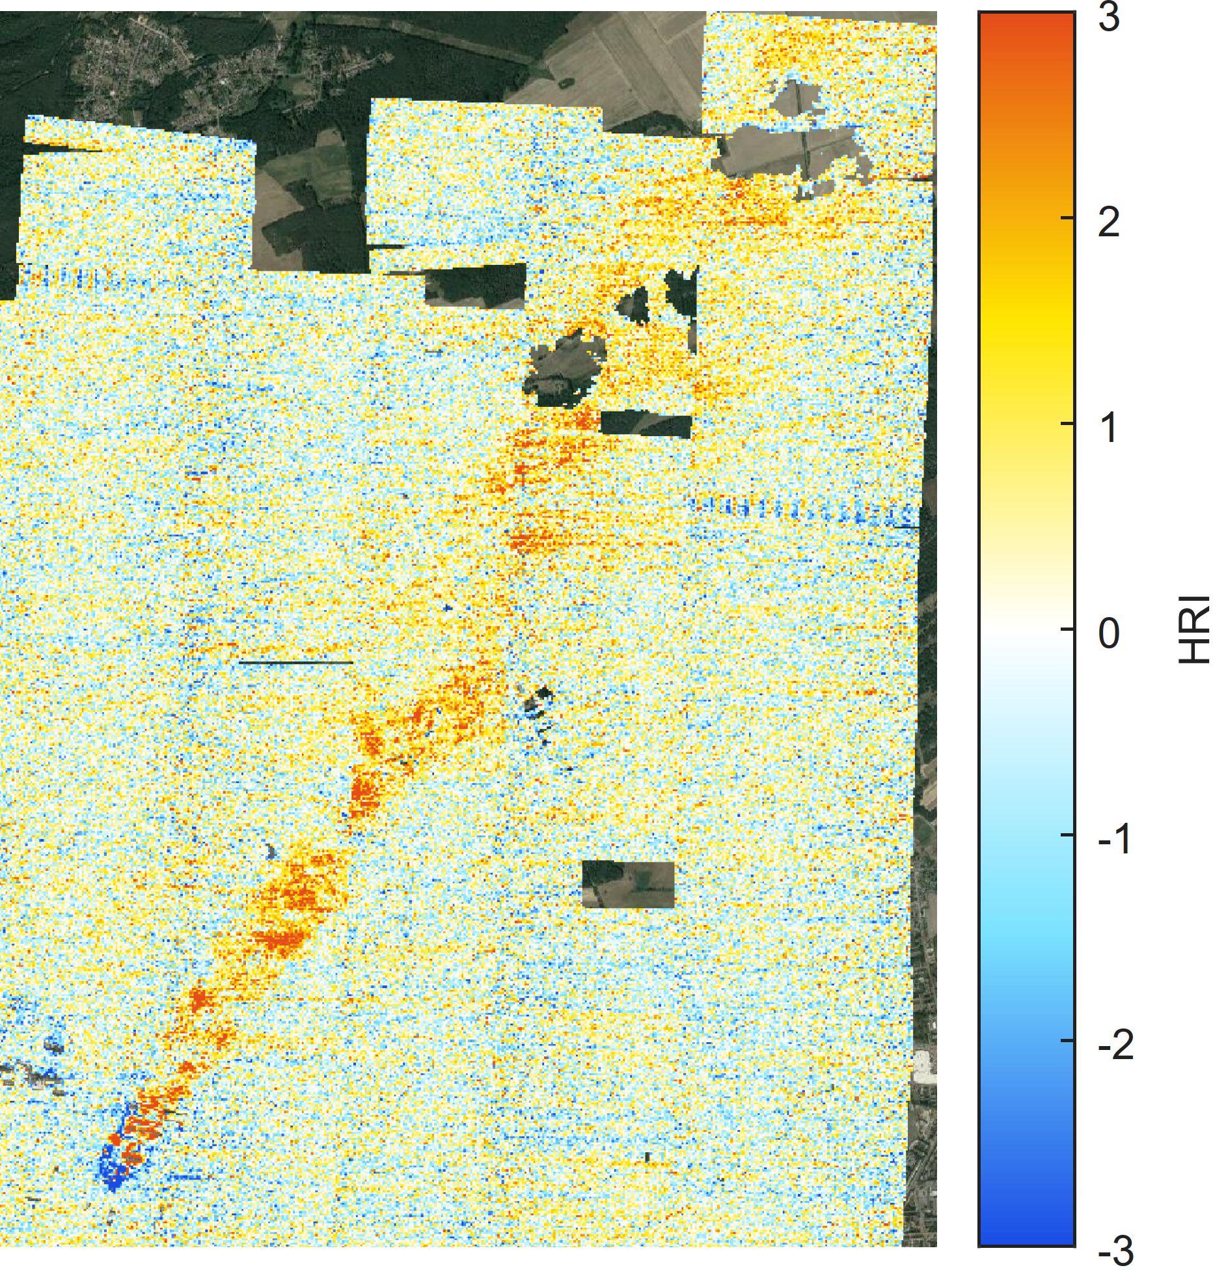
Deriving point source emission rates
Two methods used to derive emission fluxes from the plant:
Integrated mass enhancement (IME)
Cross-sectional flux (CSF)
U
$$M_{tot}$$
$${∆t}_{k}$$
$$τ_{res}$$
$$M_{k}$$
Total mass of NH₃ within the plume
Point source
Mass of NH₃ within the slice
$$Q_{IME}=\frac{M_{tot}}{τ_{res}}$$
Deposition and chemical loss
$$Q_{CSF}=\frac{M_{k}}{∆t_{k}}e^{\frac{t_{k}}{τ}}$$
Residence lifetime of NH₃ within the plume
Time for the plume to travel the slice

Slide 14
Deriving point source emission rates
Two methods used to derive emission fluxes from the plant:
Integrated mass enhancement (IME)
Cross-sectional flux (CSF)
→ Adapted for downsampled data
U
$${0.9∙M}_{ij}$$
$$M_{tot}$$
$${∆t}_{k}$$
$$τ_{res}$$
$$M_{k}$$
Total mass of NH₃ within the plume
Point source
Mass of NH₃ within the slice
$$Q_{IME}=\frac{M_{tot}}{τ_{res}}$$
Deposition and chemical loss
$$Q_{CSF}=\frac{M_{k}}{∆t_{k}}e^{\frac{t_{k}}{τ}}$$
$$M_{k}$$
Sum of the NH₃ masses calculated for each weighted pixel between two traverses
Residence lifetime of NH₃ within the plume
Time for the plume to travel the slice

Slide 15
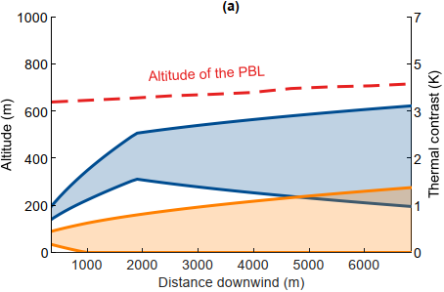
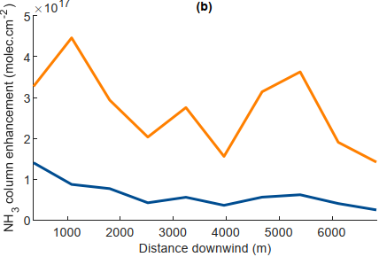
Piesteritz – Emission rate retrievals
$$TC=Tsurf – Tair$$
General behavior of the plume → Gaussian model
$$C\left(x,y\right)=C_{peak}e^{−\frac{ {\left(z−h\right)}^{2}}{2σ_{z}^{2}}}$$
$$h\left(x\right)=h_{0}+\frac{1.6 F^{\frac{1}{3}}x^{\frac{2}{3}}}{U }$$
NH₃ profile
Vertical dispersion
$$σ_{z}$$
$$h\left(x\right)$$
Initial buoyancy flux
Plume altitude
Wind

Slide 16
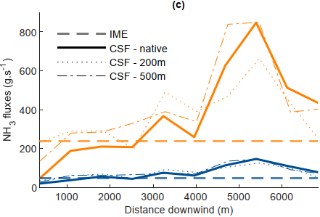
Piesteritz – Emission rate retrievals
$$TC=Tsurf – Tair$$
General behavior of the plume → Gaussian model
Emission rate retrieval :
With the IME method
With the CSF method
From native measurements and data downsampled at 200 m and 500 m resolutions
IME | 1600 t.yr⁻¹
CSF – native | 2200 t.yr⁻¹
CSF – 200 m | 2500 t.yr⁻¹
CSF – 500 m | 2500 t.yr⁻¹
E-PRTR | 400 t.yr⁻¹

Slide 17
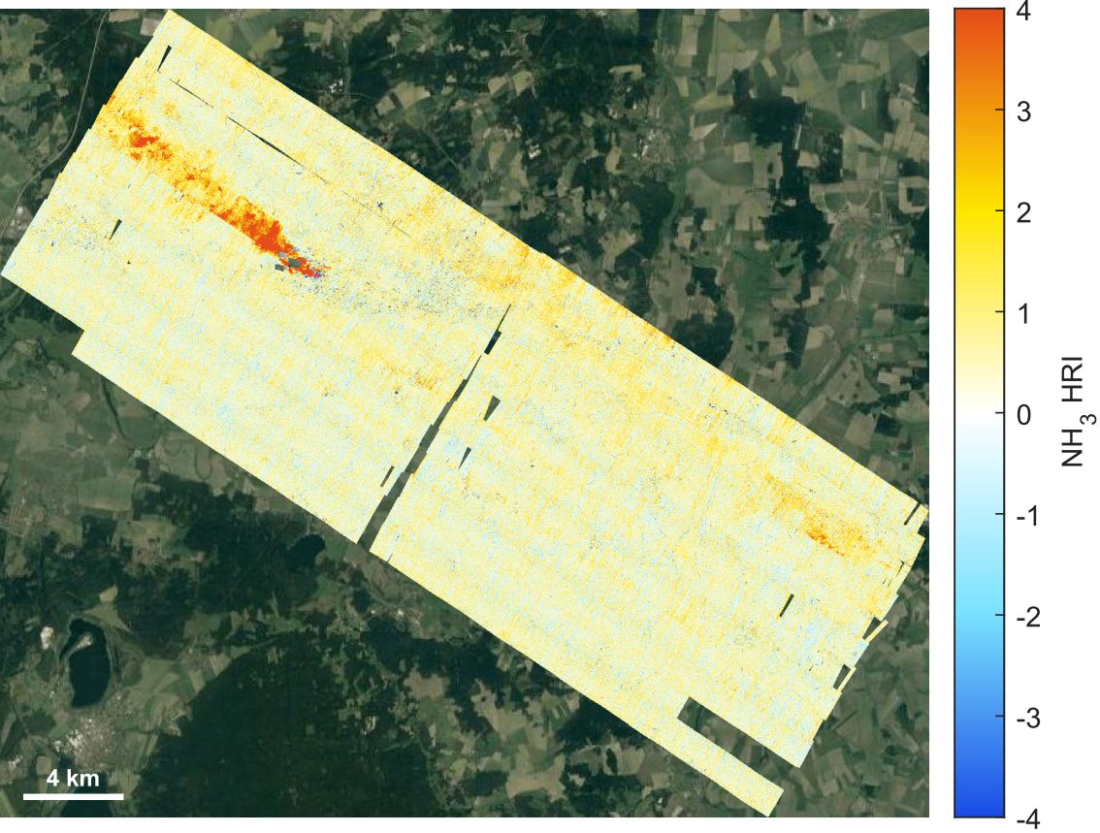
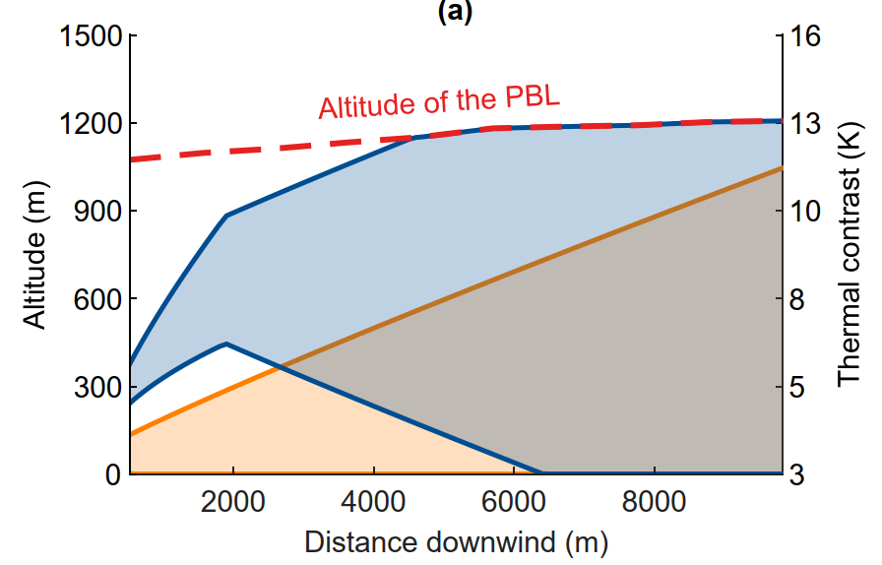
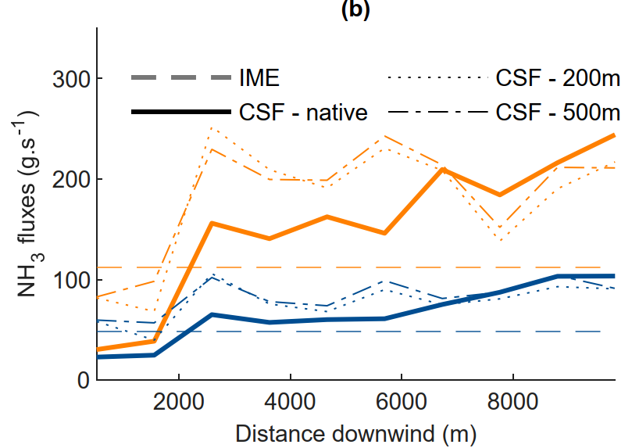
Germany flight – Piesteritz
Second flight over Piesteritz in spring 2021
Fertilizer plant
IME | 1600 t.yr⁻¹
CSF – native | 2200 t.yr⁻¹
CSF – 200 m | 2500 t.yr⁻¹
CSF – 500 m | 2500 t.yr⁻¹

Slide 18
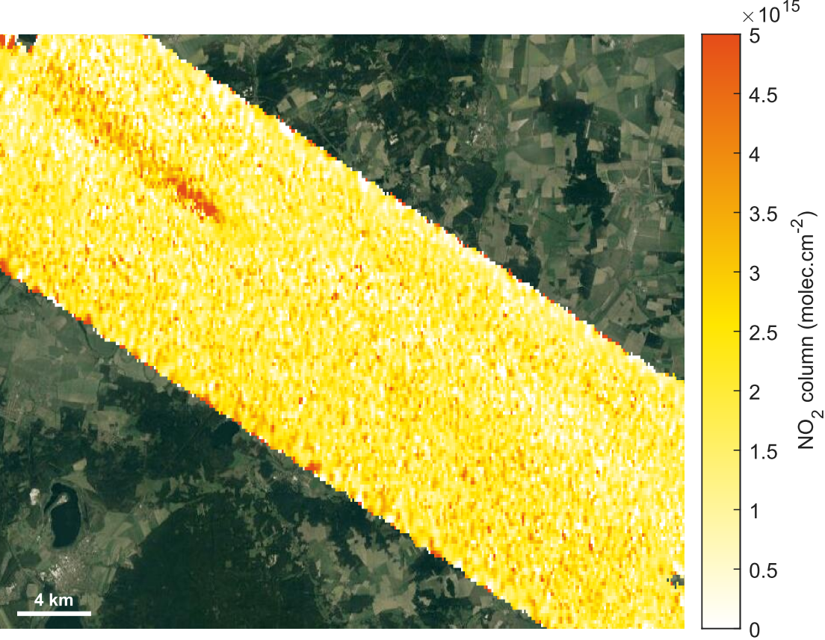
Piesteritz – Simultaneous NH₃ / NO₂ plumes
NH₃ detected in the infrared
NO₂ detected in the UV-vis
Fertilizer plant
Fertilizer plant

Slide 19
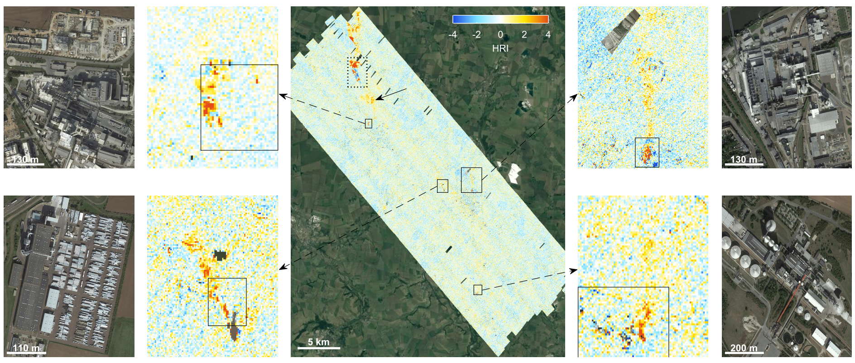
Germany flight – Staßfurt
Flight over a large area in Staßfurt in spring 2021
Detection of various NH₃ industrial sources
Soda ash plant
Soda ash plant
Wool production factory
Sugar factory

Slide 20
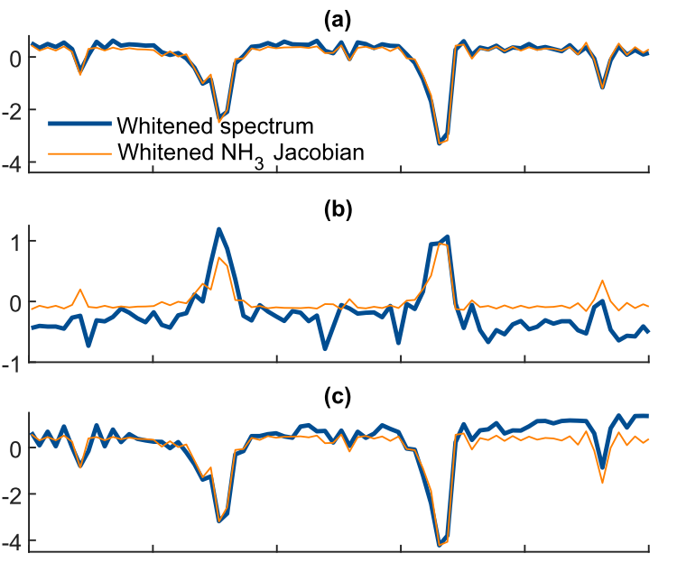
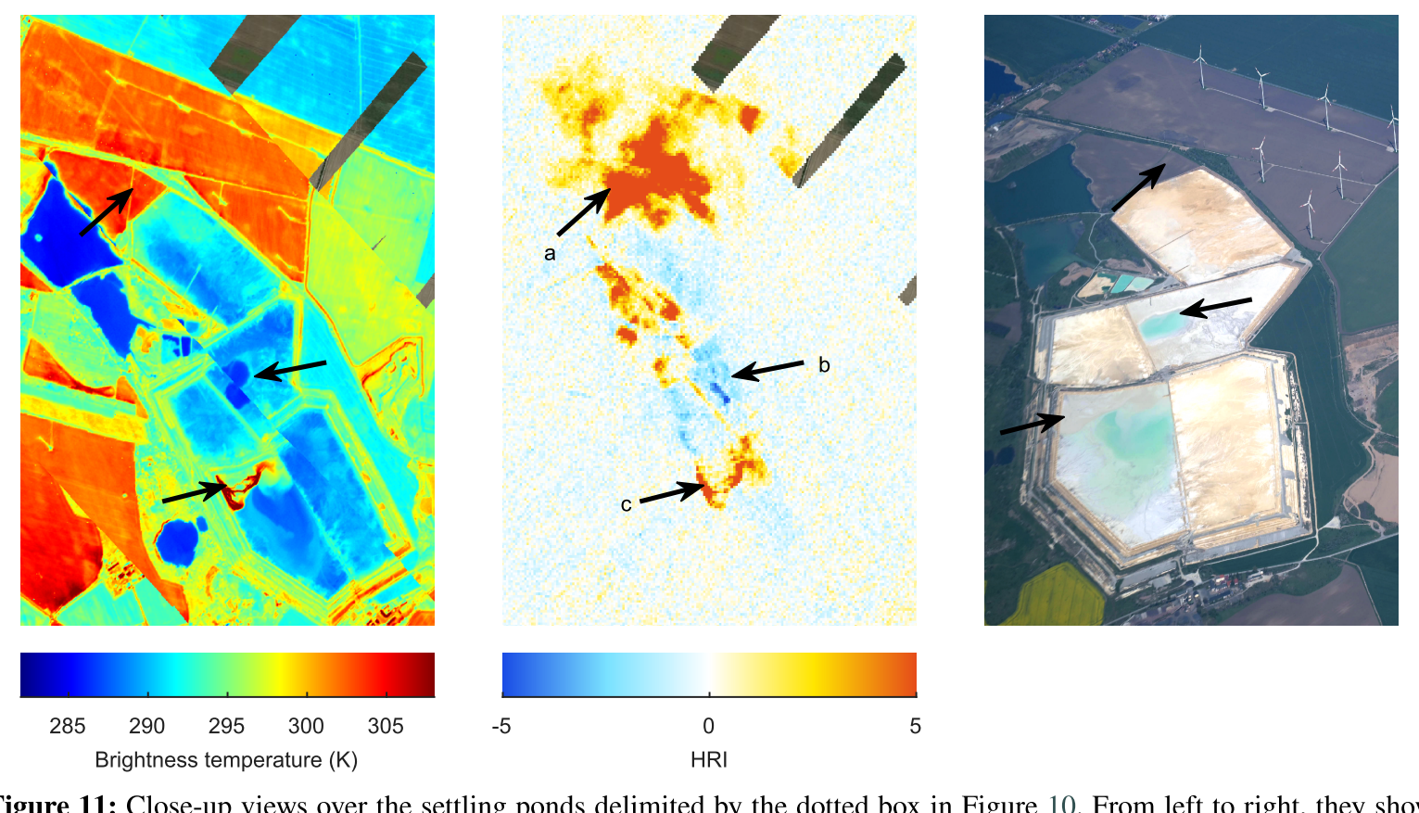
Staßfurt – Sedimentation basins
Including the sedimentation basins associated with the soda ash plant of Staßfurt
Not in the E-PRTR register
Confirmation with the whitening technique
Soda ash plant
Soda ash plant
Wool production factory
Sugar factory

Slide 21
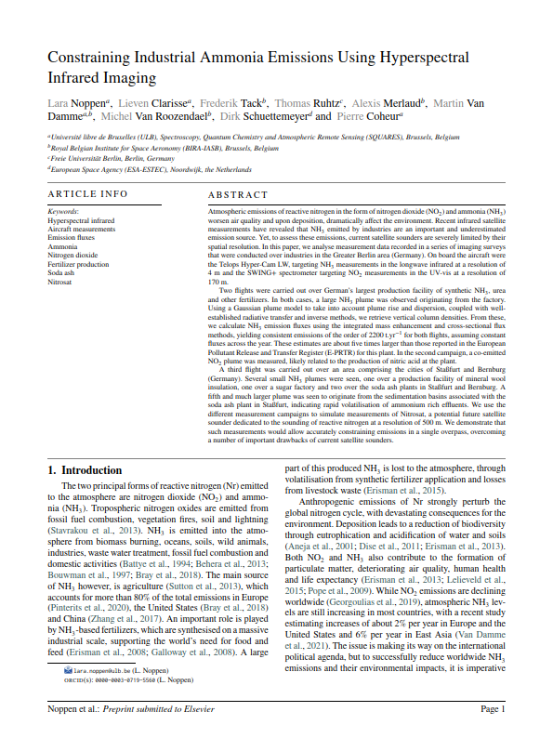
Staßfurt – Sedimentation basins
Including the sedimentation basins associated with the soda ash plant of Staßfurt
Not in the E-PRTR register
Confirmation with the whitening technique
Soda ash plant
Soda ash plant
Wool production factory
Sugar factory

Slide 22
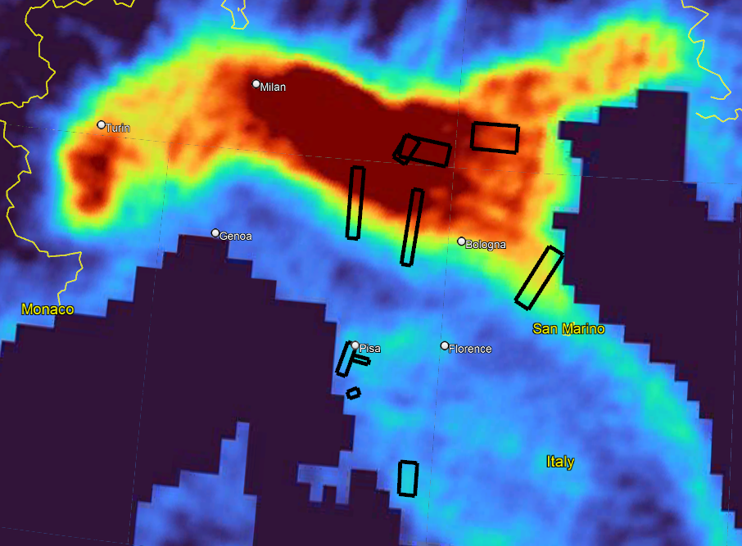
Italy flights
13-05-22 | Mantua
14-05-22 | Grosseto (experiment)
15-05-22 | Grosseto
17-05-22 | Grosseto
19-05-22 | Rosignano
20-05-22 | Este
18-06-22 | Mantua
20-06-22 | Livorno
21-06-22 | Ravenna (part 1)
22-06-22 | Ravenna (part 2)
24-06-22 | Modena
26-06-22 | Mantua (night)
27-06-22 | Ravenna (north)
30-06-22 | Parma
Mantua
Este
Parma
Modena
Ravenna
Livorno
Rosignano
Grosseto

Slide 23
Italy flights
13-05-22 | Mantua
14-05-22 | Grosseto (experiment)
15-05-22 | Grosseto
17-05-22 | Grosseto
19-05-22 | Rosignano
18-06-22 | Mantua
26-06-22 | Mantua (night)
30-06-22 | Parma
Mantua
Este
Parma
Modena
Ravenna
Livorno
Rosignano
Grosseto

Slide 24
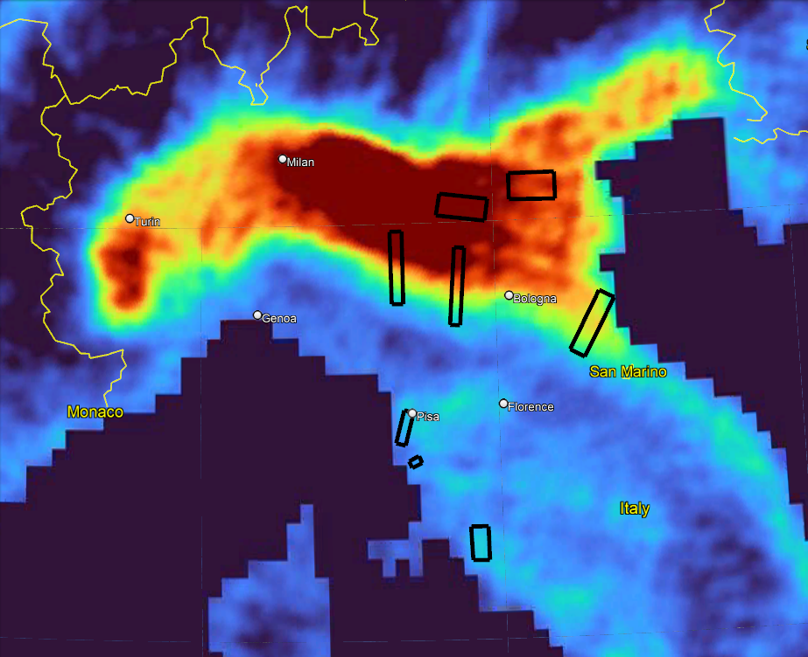
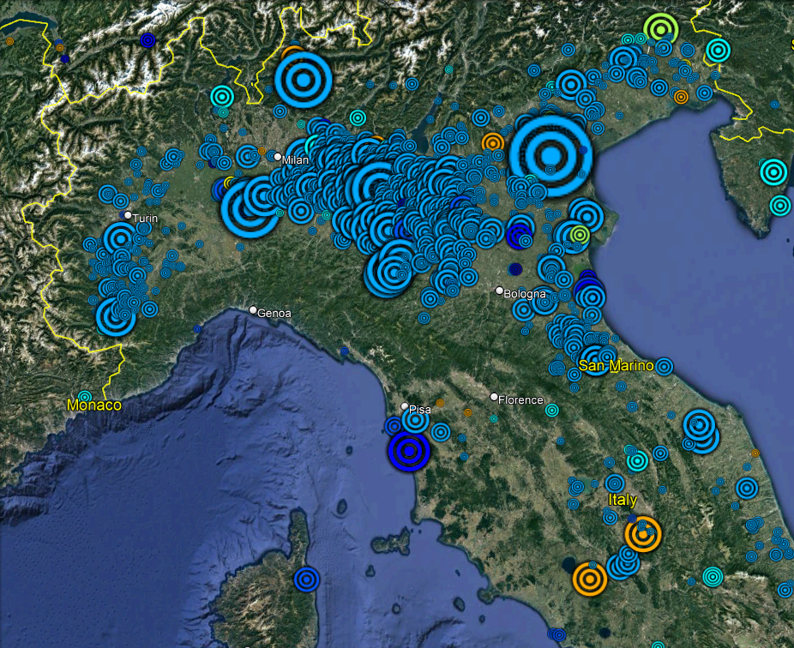
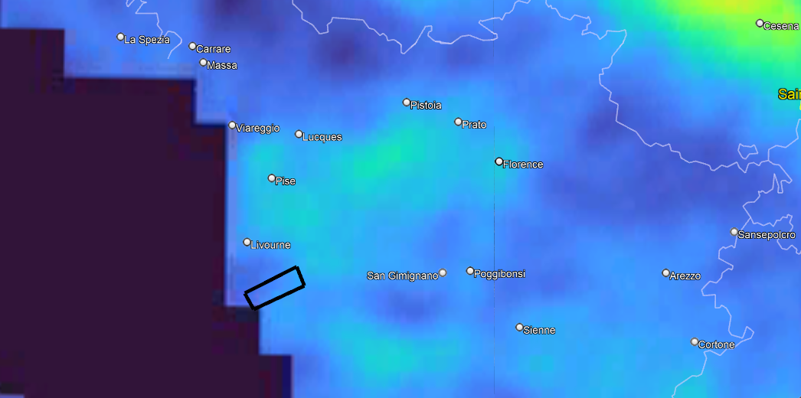
Italy flights – NH₃ sources
The Po Valley is the highest hotspot of NH₃ in Europe
→ agriculture
NH₃ observed from IASI
NH₃ emissions included in the E-PRTR inventory
Paper and wood production processing
Intensive livestock production and aquaculture
Chemical industry
Mineral industry
Waste and wastewater management

Slide 25
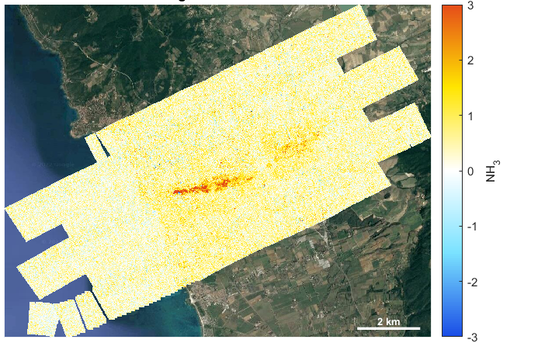
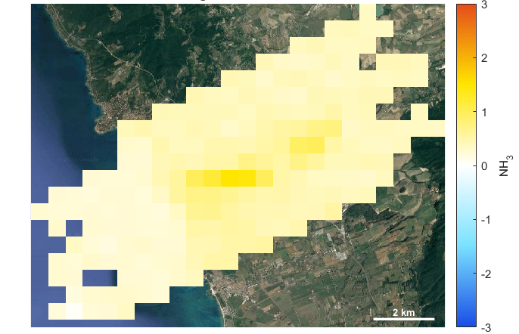
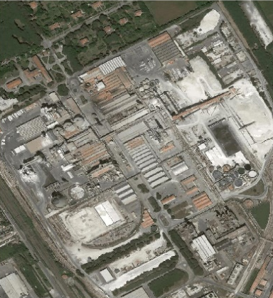
Italy flight – Rosignano
Flight over the soda ash plant of Rosignano in spring 2022
NITROCAM – 12 m
Nitrosat – 500 m
Soda ash plant

Slide 26
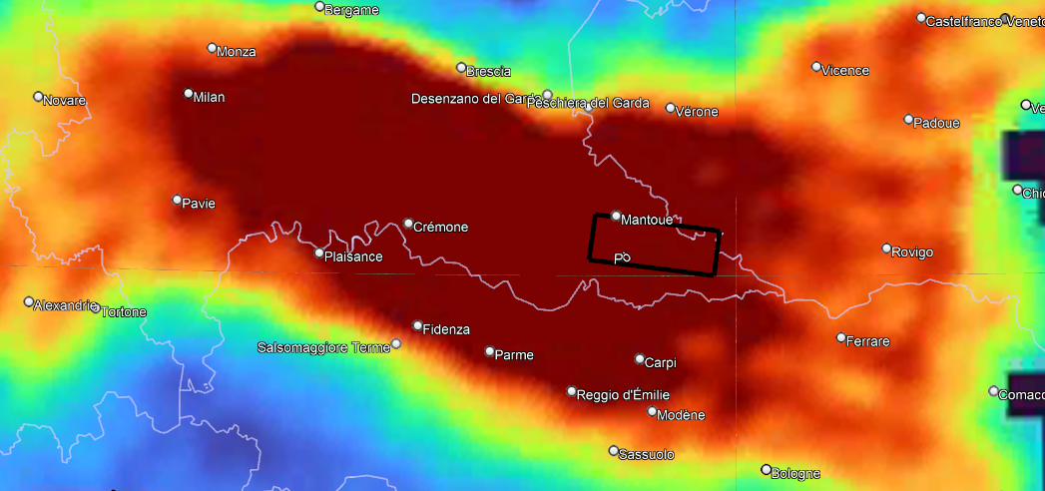
Italy flight – Mantua
Flight over the agricultural area of Mantua in spring 2022
NH₃ distribution from 2 years of IASI measurements

Slide 27
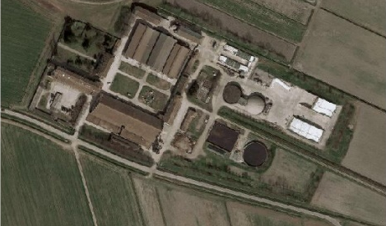
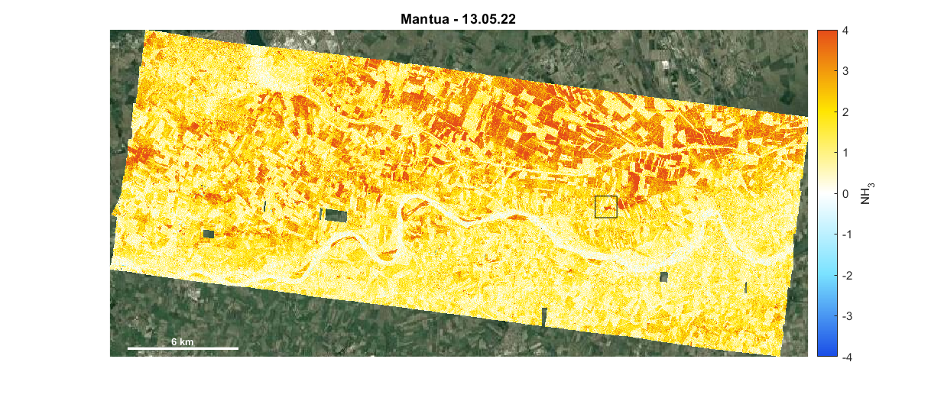
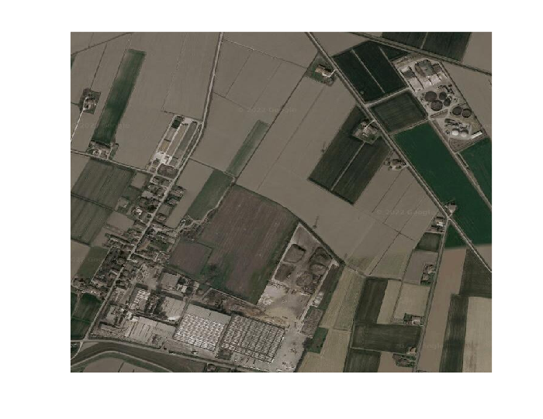
Italy flight – Mantua
Flight over the agricultural area of Mantua in spring 2022
Farm
Farm
Farm
Farm
Chipboard producing

Slide 28
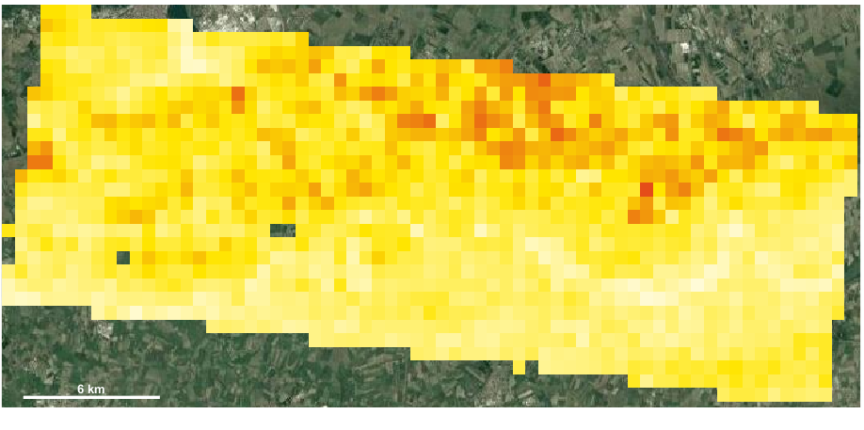
Italy flight – Mantua
Flight over the agricultural area of Mantua in spring 2022
Farm
Farm
Farm
Farm
Nitrosat – 500 m
Chipboard producing

Slide 29
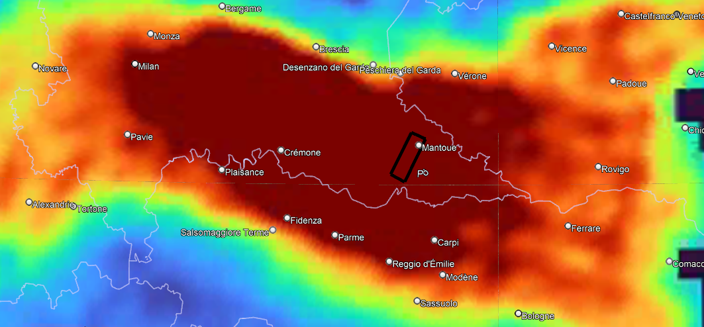
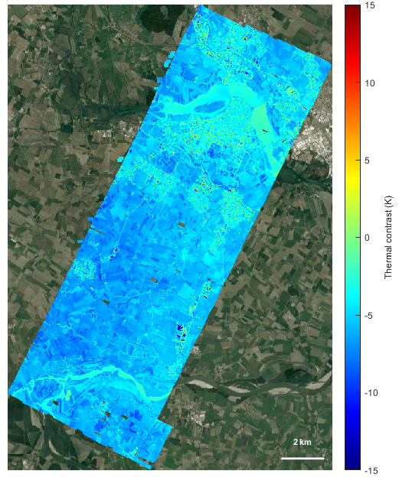
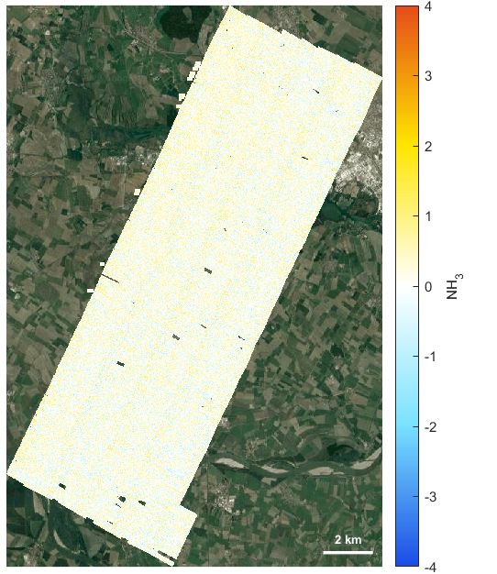
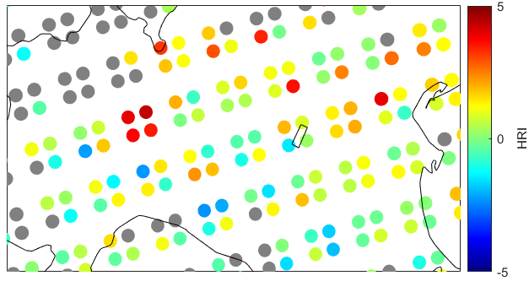
Italy flight – Mantua
Flight over Mantua during nighttime
What is expected :
TC = T_{surf} – T_{air} < 0
Emission spectra
HRI < 0
Average TC
- 5.55 K
IASI measurements

Slide 30
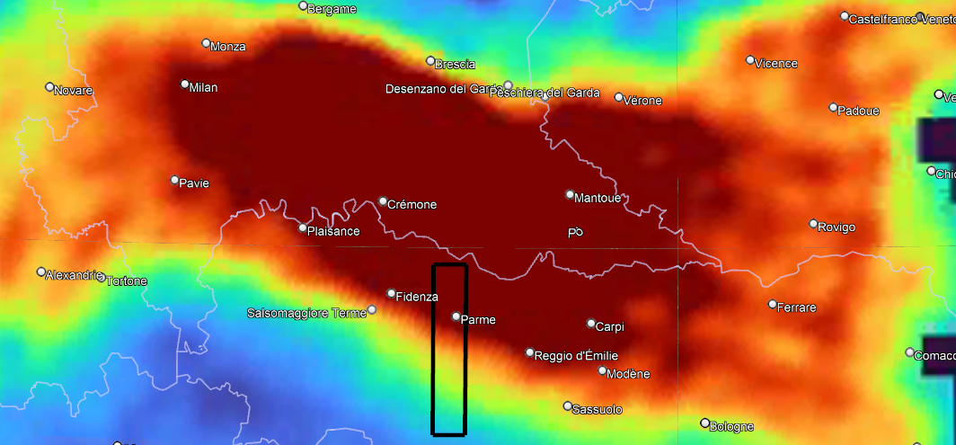
Italy flight – Parma
Flight over the region of Parma
NH₃ distribution from 2 years of IASI measurements

Slide 31
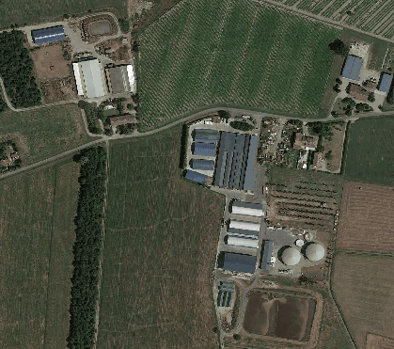
Italy flight – Parma
Flight over the region of Parma
Gradient of NH₃

Slide 32
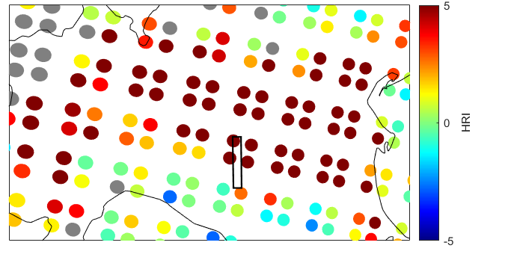
Italy flight – Parma
NITROCAM - 12 m
Nitrosat - 500 m
Flight over the region of Parma
Gradient of NH₃
IASI measurements

Slide 33
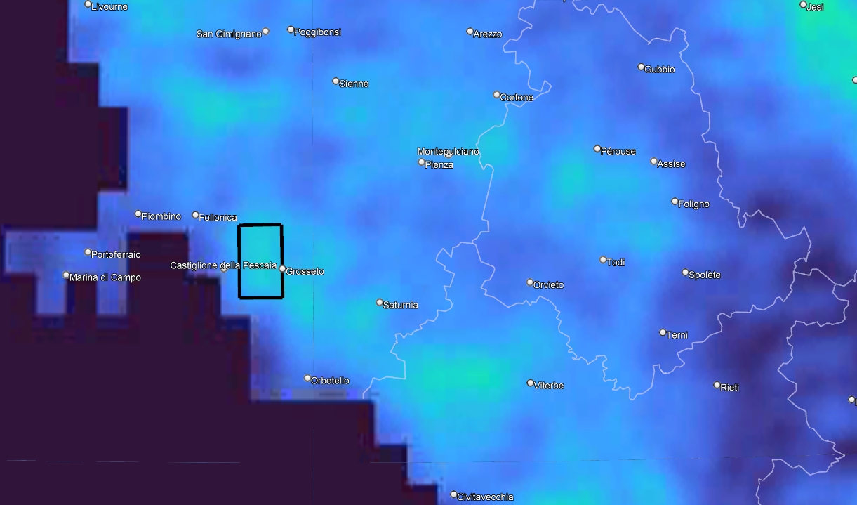
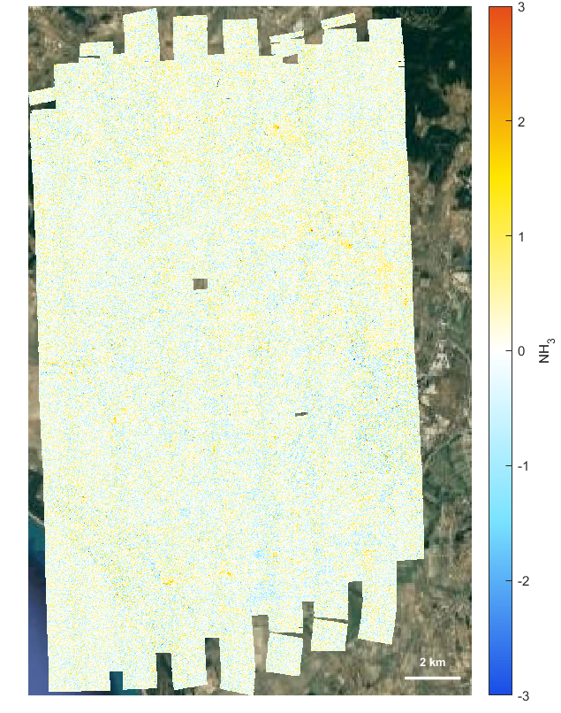
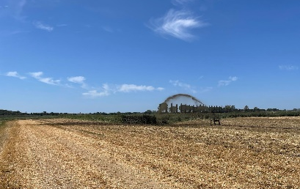
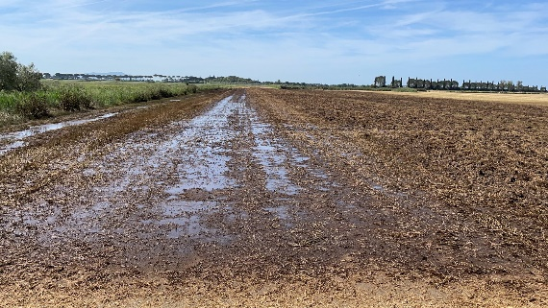
Italy flight – Grosseto
Flight over a fertilizer experiment in Grosseto

Slide 34
Italy flight – Grosseto
Flight over a fertilizer experiment in Grosseto
NITROCAM – 12 m
Nitrosat – 500 m

Slide 35
Grosseto – One day after the release
Lagoons
Cows
Greenhouses

Slide 36
Grosseto
One day after the fertilizer experiment
Three days after the fertilizer experiment
NITROCAM – 12 m
Lagoons
Cows
Greenhouses

Slide 37
Grosseto
One day after the fertilizer experiment
Three days after the fertilizer experiment
Degradation of the spatial resolution at 500 m
Detection of one plume coming from the farm
Nitrosat – 500 m
Nitrosat – 500 m

Slide 38
Conclusions
Limitation of current sounders for observing/estimating NH₃ emissions
→ the satellite Nitrosat
→ supported by the NITROCAM aircraft campaigns
The driving uncertainty for quantifying emissions : the plume behavior
Some small industrial point sources will be missed at 500 m resolution
Individual farms and freshly fertilized fields can be detected
Multiple overpasses needed to constrain emissions on an individual farm level and to distinguish point sources from fertilized field

Slide 39
Thank you!

